Slide 1
Face Mask Detection
Computer Vision - Fall 2022
PRESENTED BY Yang Liu, Junzhou Liu, Yiran Ma
12/14/2022

Slide 2
Introduction and Data Preparation
01

Slide 3
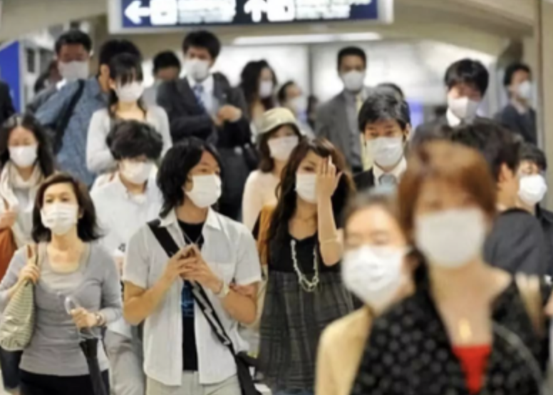
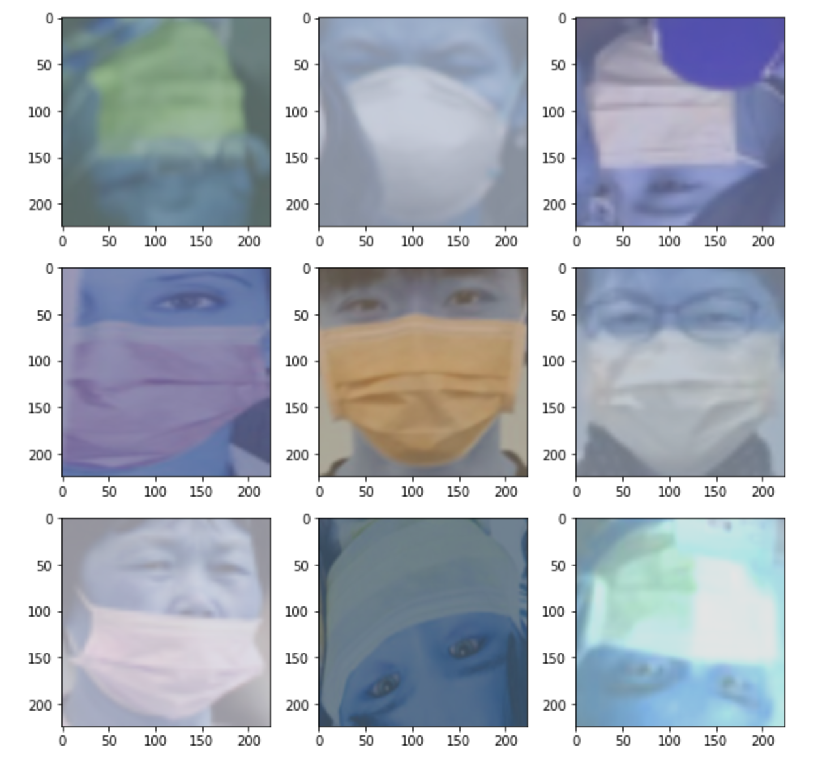
In this project, We explore some existed detection modules and want to eventually develop modules capable of detecting whether wearing masks on given pictures.
Analyze XML inputs and use Geometric Augmentation[1] and Intensity Augmentation[2] to avoid overfitting and expand diversity of dataset

Slide 4
VGG16 Model
02

Slide 5
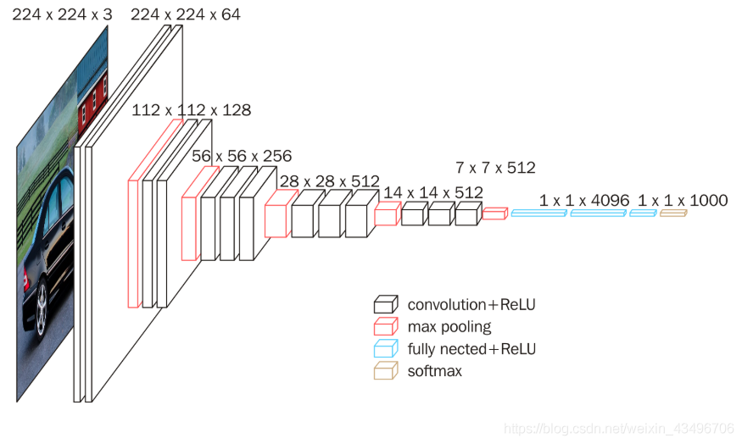
VGG16
VGG has 16 layers with weights.
In VGG16 there are 13 convolutional layer
VGG16 takes input tensor size as 224, 244 with 3 RGB channel.
The three FC (Fully Connected) Layers follow a stack of convolutional layers.
The first two has 4096 channels each.
The 3rd performs 100-way ILSVRC classification about 1000 channels.
The final layer is the soft-max layer
Notes:
VGG16 is one of the most popular and clean architecture convolutional neural networks. It is essentially based on just using three by three convolutions. It has several advantages such as the architecture is quite simple in terms of building layers, 3*3 convolutions, same padding and 2*2 max pooling. The disadvantages could be taking quite a long time to train the model since it has an enormous amount of parameters and numerous layers. Our model forced on having 13 convolution layers that each nodes that varies in 64, 128, 256, 512 in a 3*3 filter with stride 1 and always use the same padding. We also applied batch normalization to standardize the inputs to the layer for each mini-batch, stabilize our model if applying a high learning rate and dramatically reduce the number of training epochs required to train deep networks.. In between these convolution layers, maxpool layer was implemented in a 2*2 filter with stride 2. It follows the arrangement of convolution and max pool layers consistently throughout the whole structure. In the end it has a fully connected layer with 4096 nodes. Dropout with rate 0.5 is applied inside the fully connected layer, which offers a very computationally cheap and remarkably effective regularization method to reduce overfitting and improve generalization error in deep neural networks of all kinds.

Slide 6
Faster-RCNN Model
03

Slide 7
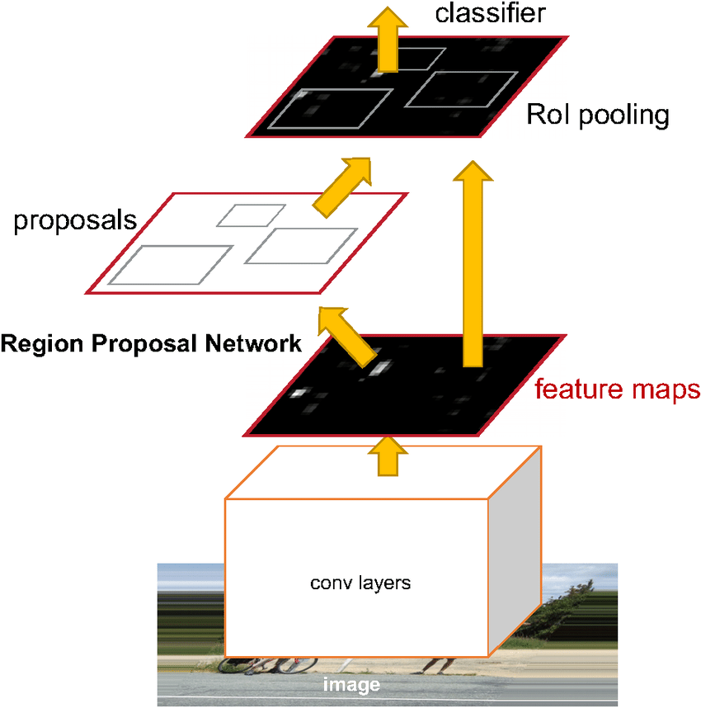
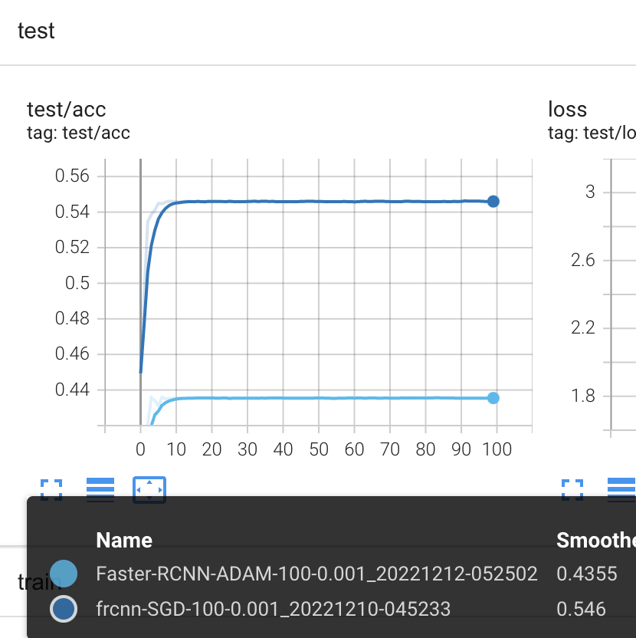
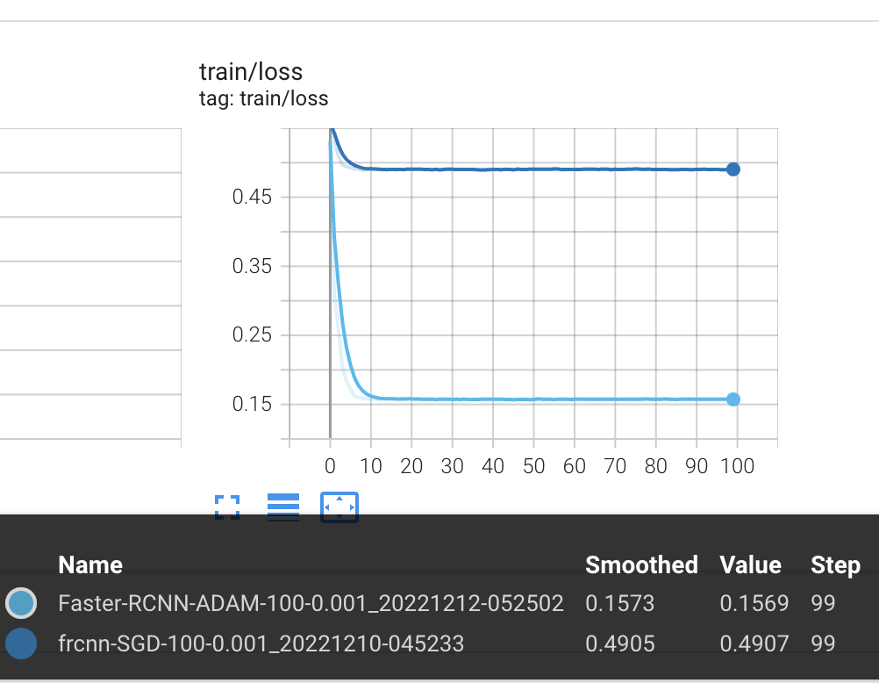
FASTER-RCNN
Compared with RCNN and Fast RCNN according to the relevant experimental data results, Faster-RCNN is more efficient and accuracy.
The Adam optimizer may perform better than the SGD(stochastic gradient descent) optimizer.

Slide 8
Conclusion
04

Slide 9
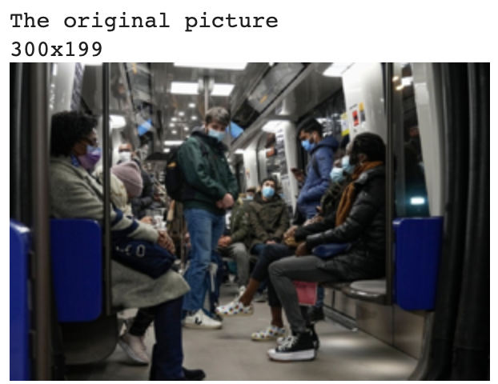
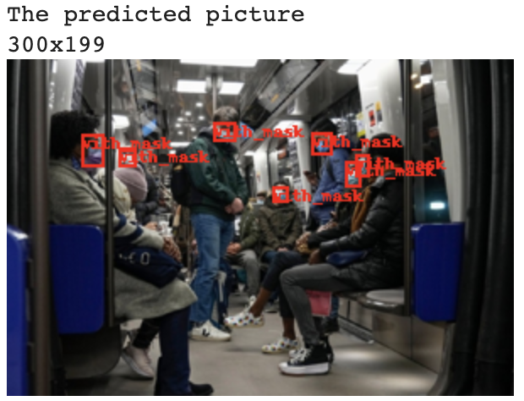
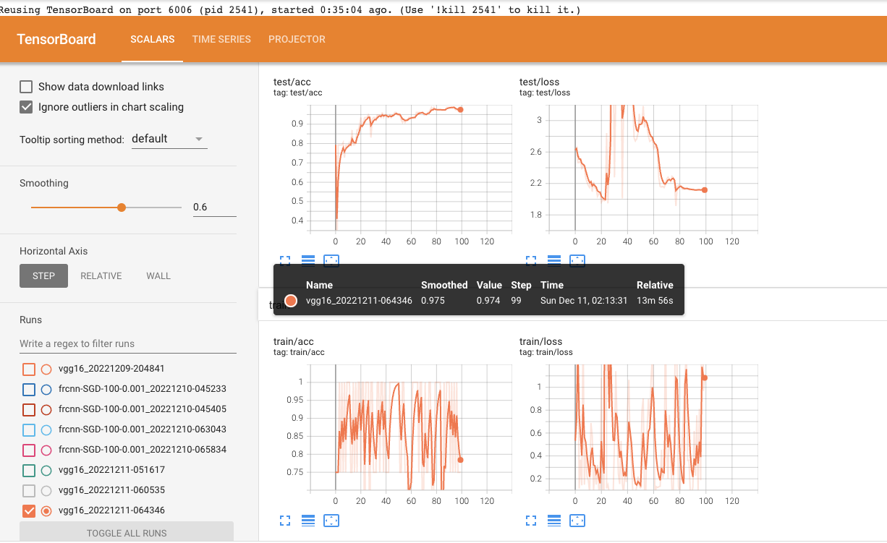
VGG16 : accuracy 97.5%
Faster-RCNN : mean average precision[3] 0.47

Slide 10
Reference
[1] M. Elgendi, M. U. Nasir, Q. Tang, D. Smith, J.- P. Grenier, C. Batte, B. Spieler, W. D. Leslie, C. Menon, R. R. Fletcher et al., “The effectiveness of image augmentation in deep learning networks for detecting covid-19: A geometric transformation perspective,” Frontiers in Medicine, vol. 8, p. 629134, 2021.
[2] L. S. Hesse, G. Kuling, M. Veta, and A. L. Martel, “Intensity augmentation to improve generalizability of breast segmentation across different mri scan protocols,” IEEE Transactions on Biomedical Engineering, vol. 68, no. 3, pp. 759–770, 2020.
[3] R. M. Gottsdanker, “The accuracy of prediction motion.” Journal of Experimental Psychology, vol. 43, no. 1, p. 26, 1952.

